Slide 1

Perancangan Sistem Pemrograman
UML State Machine Diagrams and Modeling
Prepared by Frans Panduwinata, S.Kom, M.T

Slide 2

Introduction
Use case and class diagram are static diagrams, which means
  That they help in visualizing what the elements of the complete system would be, but
  Do not say anything about the flows any object of the system can have when an event occurs.
  Structural elements are used to depict static diagrams.
State diagrams depict the dynamic behavior of the entire system, or a sub-system, or even a single object in a system. This is done with the help of Behavioral elements.

Slide 3
Introduction (cont)
A UML state machine diagram illustrates
  Events and states of an object, and
  The behavior of an object in reaction to an event.
Symbols:
  Transitions are shown as arrows, labeled with their event.
  States are shown in rounded rectangles.

Slide 4
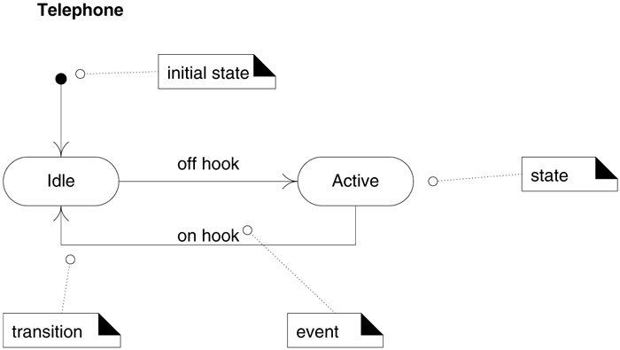
Introduction (cont)
EXAMPLE:

Slide 5
Introduction (cont)
A state machine diagram shows the lifecycle of an object:
  What events it experiences,
  Its transitions, and
  The states it is in between these events.
It need not illustrate every possible event.
Therefore, we can create a state machine diagram that describes the lifecycle of an object at arbitrarily simple or complex levels of detail, depending on our needs.

Slide 6
Definitions: Events, States, and Transitions
An event is a significant or noteworthy occurrence.
For EXAMPLE:
A telephone receiver is taken off the hook.
A state is the condition of an object at a moment in time the time between events.
For EXAMPLE:
A telephone is in the state of being "idle" after the receiver is placed on the hook and until it is taken off the hook.

Slide 7
Definitions: Events, States, and Transitions (cont)
A transition is a relationship between two states that indicates that when an event occurs, the object moves from the prior state to the subsequent state.
For EXAMPLE:
When the event "off hook" occurs, transition the telephone from the "idle" to "active" state.

Slide 8
How to Apply State Machine Diagrams?
State-Independent and State-Dependent Objects
  State-independent object is that If an object always responds the same way to an event.
  For EXAMPLE, If, for all events of interest, an object always reacts the same way, it is a state-independent object.
  State-dependent objects react differently to events depending on their state or mode.
  For EXAMPLE, a telephone is very state-dependent. The phone's reaction to pushing a particular button (generating an event) depends on the current mode of the phone off hook, engaged, in a configuration subsystem, and so forth.

Slide 9
How to Apply State Machine Diagrams? (cont)
Modeling State-dependent Objects
Broadly, state machines are applied in two ways:
  To model the behavior of a complex reactive object in response to events.
  To model legal sequences of operations protocol or language specifications.
    This approach may be considered a specialization of model above, if the "object" is a language, protocol, or process.

Slide 10
How to Apply State Machine Diagrams? (cont)
List of common objects which are often state-dependent, and for which it may be useful to create a state machine diagram:
  Complex Reactive Objects
  Protocols and Legal Sequences

Slide 11
How to Apply State Machine Diagrams? (cont)
Complex Reactive Objects
  Physical Devices controlled by software
  Phone, car, microwave oven: They have complex and rich reactions to events, and the reaction depends upon their current mode.
  Transactions and related Business Objects
  How does a business object (a sale, order, payment) react to an event?
  For EXAMPLE, what should happen to an Order if a cancel event occurs? And understanding all the events and states that a Package can go through in the shipping business can help with design, validation, and process improvement.

Slide 12
How to Apply State Machine Diagrams? (cont)
Complex Reactive Objects (cont)
  Role Mutators. These are objects that change their role.
  A Person changing roles from being a civilian to a veteran. Each role is represented by a state.

Slide 13
How to Apply State Machine Diagrams? (cont)
Protocols and Legal Sequences
  Communication Protocols
  TCP, and new protocols, can be easily and clearly understood with a state machine diagram.
  For EXAMPLE, a TCP "close" request should be ignored if the protocol handler is already in the "closed" state.
  UI Page/Window Flow or Navigation
  When doing UI modeling, it can be useful to understand the legal sequence between Web pages or windows; this is often complex.

Slide 14
How to Apply State Machine Diagrams? (cont)
Protocols and Legal Sequences (cont)
  UI Flow Controllers or Sessions
  Specifically focused on server-side objects representing an ongoing session or conversations with a client.
  For EXAMPLE, a Web application that remembers the state of the session with a Web client and controls the transitions to new Web pages, or the modified display of the current Web page, based upon the state of the session and the next operation that is received.

Slide 15
How to Apply State Machine Diagrams? (cont)
Protocols and Legal Sequences (cont)
  Use Case System Operations
  Do you recall the system operations for Process Sale: makeNewSale, enterItem, and so forth? These should arrive in a legal order; for EXAMPLE, endSale should only come after one or more enterItem operations.
  Individual UI Window Event Handling
  Understanding the events and legal sequences for one window or form.
  For EXAMPLE, the Edit-Paste action is only valid if there is something in the "clipboard" to paste.

Slide 16
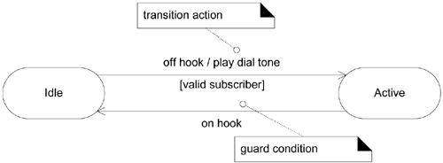
More UML State Machine Diagram Notation
Transition Actions and Guards
  A transition can cause an action to fire. In a software implementation, this may represent the invocation of a method of the class of the state machine diagram.
  A transition may also have a conditional guard or boolean test. The transition only occurs if the test passes.

Slide 17
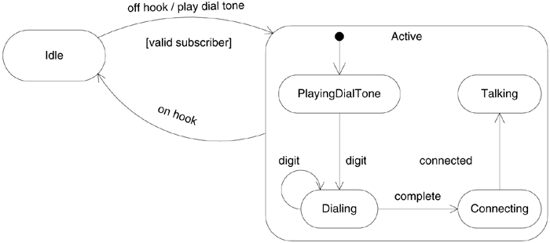
More UML State Machine Diagram Notation (cont)
Nested States
  A state allows nesting to contain substates; a substate inherits the transitions of its superstate (the enclosing state).
  For EXAMPLE, when a transition to the Active state occurs, creation and transition into the PlayingDialTone substate occurs. No matter what substate the object is in, if the on hook event related to the Active superstate occurs, a transition to the Idle state occurs.

Slide 18
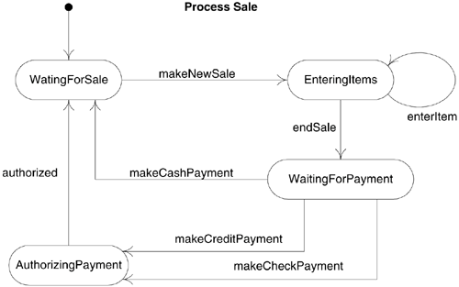
Example
NextGen Use Case State Machine Diagram

Slide 19
Exercise
A library contains books and journals. The task is to develop a
computer system for borrowing books. In order to borrow a
book the borrower must be a member of the library. There is a
limit on the number of books that can be borrowed by each
member of the library. The library may have several copies of
a given book. It is possible to reserve a book. Some books are
for short term loans only. Other books may be borrowed for 3
weeks. Users can extend the loans.
TASK:
Draw state machine diagrams for a library.

